Slide 1
Prevent and Channel Overview
February 2025

Slide 2
National Counter Terrorism Strategy CONTEST
Prepare – Mitigate the impact of a terrorist incident if it occurs
Prevent – Safeguarding people from becoming terrorist or supporting terrorism
Protect – Strengthen our protection against a terrorist attack in the UK or overseas
Pursue – Stopping terrorist attacks happening in the UK and overseas

Slide 3
What is Prevent?
The Prevent Duty in the Counter-Terrorism and Security Act 2015 seeks to safeguard and support those vulnerable to radicalisation.
The Prevent strategy has three objectives:
Respond to the ideological challenge of terrorism and the threat we face from those who promote it
Prevent people from being drawn into terrorism and ensure that they are given appropriate advice and support
Work with sectors and institutions where there are risks of radicalisation that we need to address.
Prevent: An Introduction

Slide 4
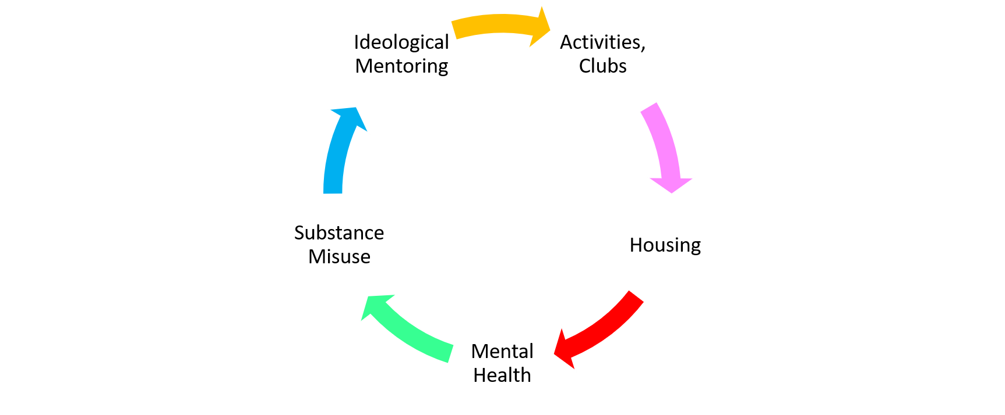
What is Channel?
Multi-agency panel of relevant professionals that:
Assesses engagement, capability and intent
Provides support to people identified as vulnerable to radicalisation
Tailors support to the individuals needs.
Key Points
It requires consent to engage with interventions
It is confidential
It does not criminalise people

Slide 5
Prevent Referral Process?
Concern identified and discussed with Safeguarding or Prevent Lead
Concern referred to local Prevent team via Prevent Referral
Police intelligence gather information, assess risk and whether the individual is suitable for Channel. (If there are safeguarding concerns but no relevance to counter terrorism they will be referred to Contact Swindon
If there are additional safeguarding concerns please refer to Contact Swindon or other relevant MASH team
If Counter Terrorism Policing South West deem the individual suitable to receive Channel support, they will refer to the local authority chaired Channel Panel
Local authority co-ordination of professionals appropriate to the individual
Panel meets to assess risk and determine whether individual/s are adopted into channel. If adopted, panel will seek consent to engage and develop a support programme based on their needs. Panel will meet on a monthly basis to assess progress and amend support as required

Slide 6
How might I identify susceptibility to signs of radicalisation?
Key Points:
There is NOT a single profile of radicalisation.
It is unlikely to be just one factor but a combination, understanding context is part of the Channel process in assessing level of risk.
Radicalisation can occur regardless of age, gender, lifestyle, beliefs or religion.
Possession of extreme materials or symbols e.g. swastikas | “Them” and “Us” thinking
Change in language to include racist, offensive words | Isolation from family – friendship group
Talking about / planning violent action | Watching, sharing, or creating films online linked to religious, political, or racial hate
Feelings of grievance or injustice | Being at a transitional time of life or personal crisis
Need for identity, status or a sense of belonging | Family or friends holding or being involved with extremist ideas
Desire for political, social or moral change | Being influenced or controlled by a group

Slide 7
Key Contact Details
If you would like to seek advice:
Contact the Prevent team at PreventReferrals@wiltshire.police.uk or 01278 647466
Call 101
Call the national Prevent advice line on 0800 011 3764 (open 9.00am – 5.00pm everyday)
To make a referral please email the Prevent team at: PreventReferrals@wiltshire.police.uk
If you would require further advice please contact: SwindonPrevent@swindon.gov.uk

Slide 8
Useful Resources
Radicalisation and extremism | Swindon Borough Council
Bing Videos
Trust Your Instincts and Report | Action Counters Terrorism
Educate Against Hate - Prevent Radicalisation & Extremism
ACT Early | Prevent radicalisation
Prevent | Swindon Community Safety Partnership

Slide 9
Online Training
Home Office E-Learning
The government training courses are designed, and are appropriate for, staff working in sectors covered by the Prevent duty.
These include education, health, local authorities, police and criminal justice agencies.
Other sectors that are not covered may also complete this training.
List of courses
Course 1 - Awareness course
Course 2 - Referrals course
Course 3 - Channel or Prevent Multi-Agency Panel (PMAP) course
List of refresher courses
Course - Refresher awareness course

Slide 10
Useful Links and Guides:
Counter-Terrorism and Security Act 2015 (legislation.gov.uk)
Counter-terrorism strategy (CONTEST) 2018 - GOV.UK (www.gov.uk)
Channel duty guidance: protecting people susceptible to radicalisation (accessible) - GOV.UK
Revised Prevent duty guidance: for England and Wales - GOV.UK (www.gov.uk)
Prevent duty toolkit for local authorities and partner agencies - GOV.UK (www.gov.uk)

Slide 11
Useful Links and Guides:
The Prevent duty: safeguarding learners vulnerable to radicalisation - GOV.UK
PREVENT - Swindon Safeguarding Partnership
Promoting fundamental British values through SMSC - GOV.UK
Hate crime - Swindon Safeguarding Partnership
Get help for radicalisation concerns - GOV.UK

